Slide 1

ELECTRONICS 101
Capacitor

Slide 2


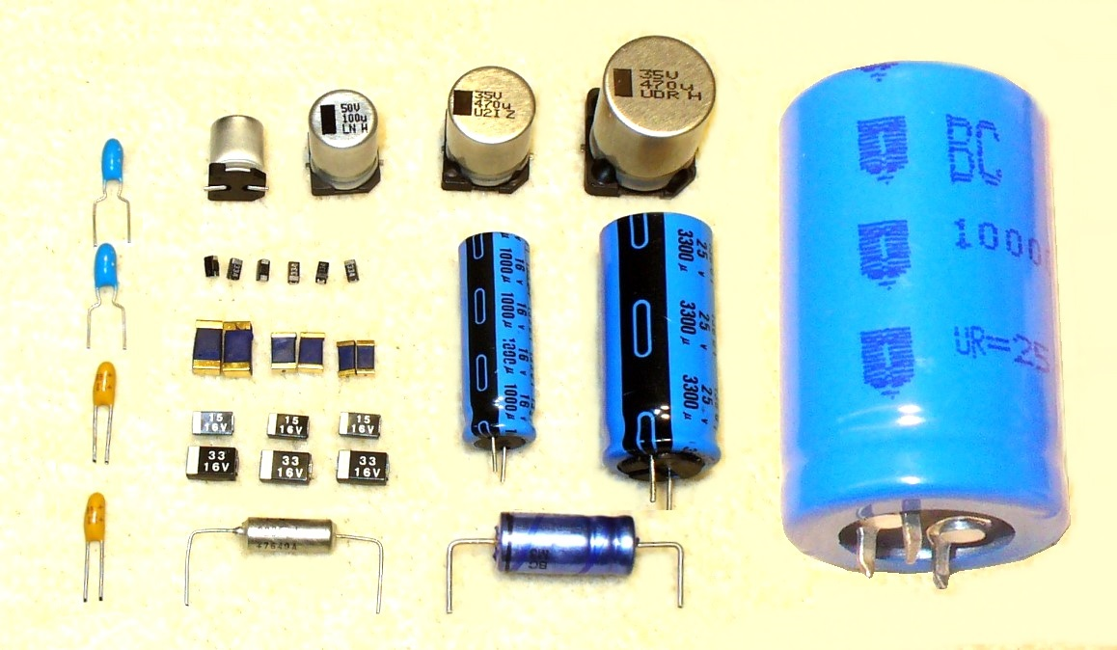
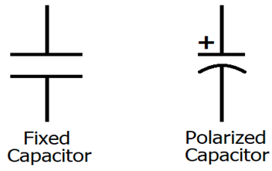
What is a Capacitor?
A component that stores charge
Very useful for mostly AC circuits
There are different kinds of Capacitor
Measured in Farad (F)
Most (if not all) have dipole material
Discharge when the device shuts off or circuit is broken
Symbol for Capacitor

Slide 3
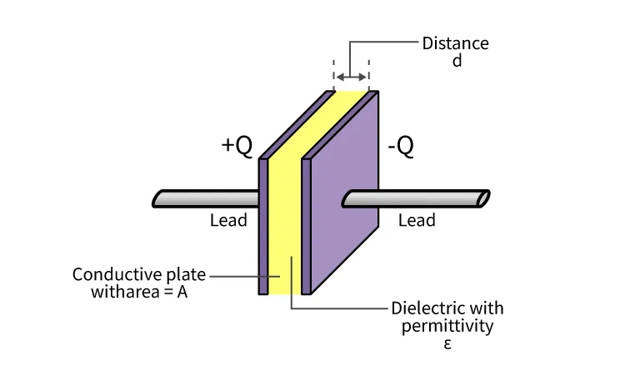
Anatomy of Capacitor

Slide 4
Equation(s)

